Slide 1
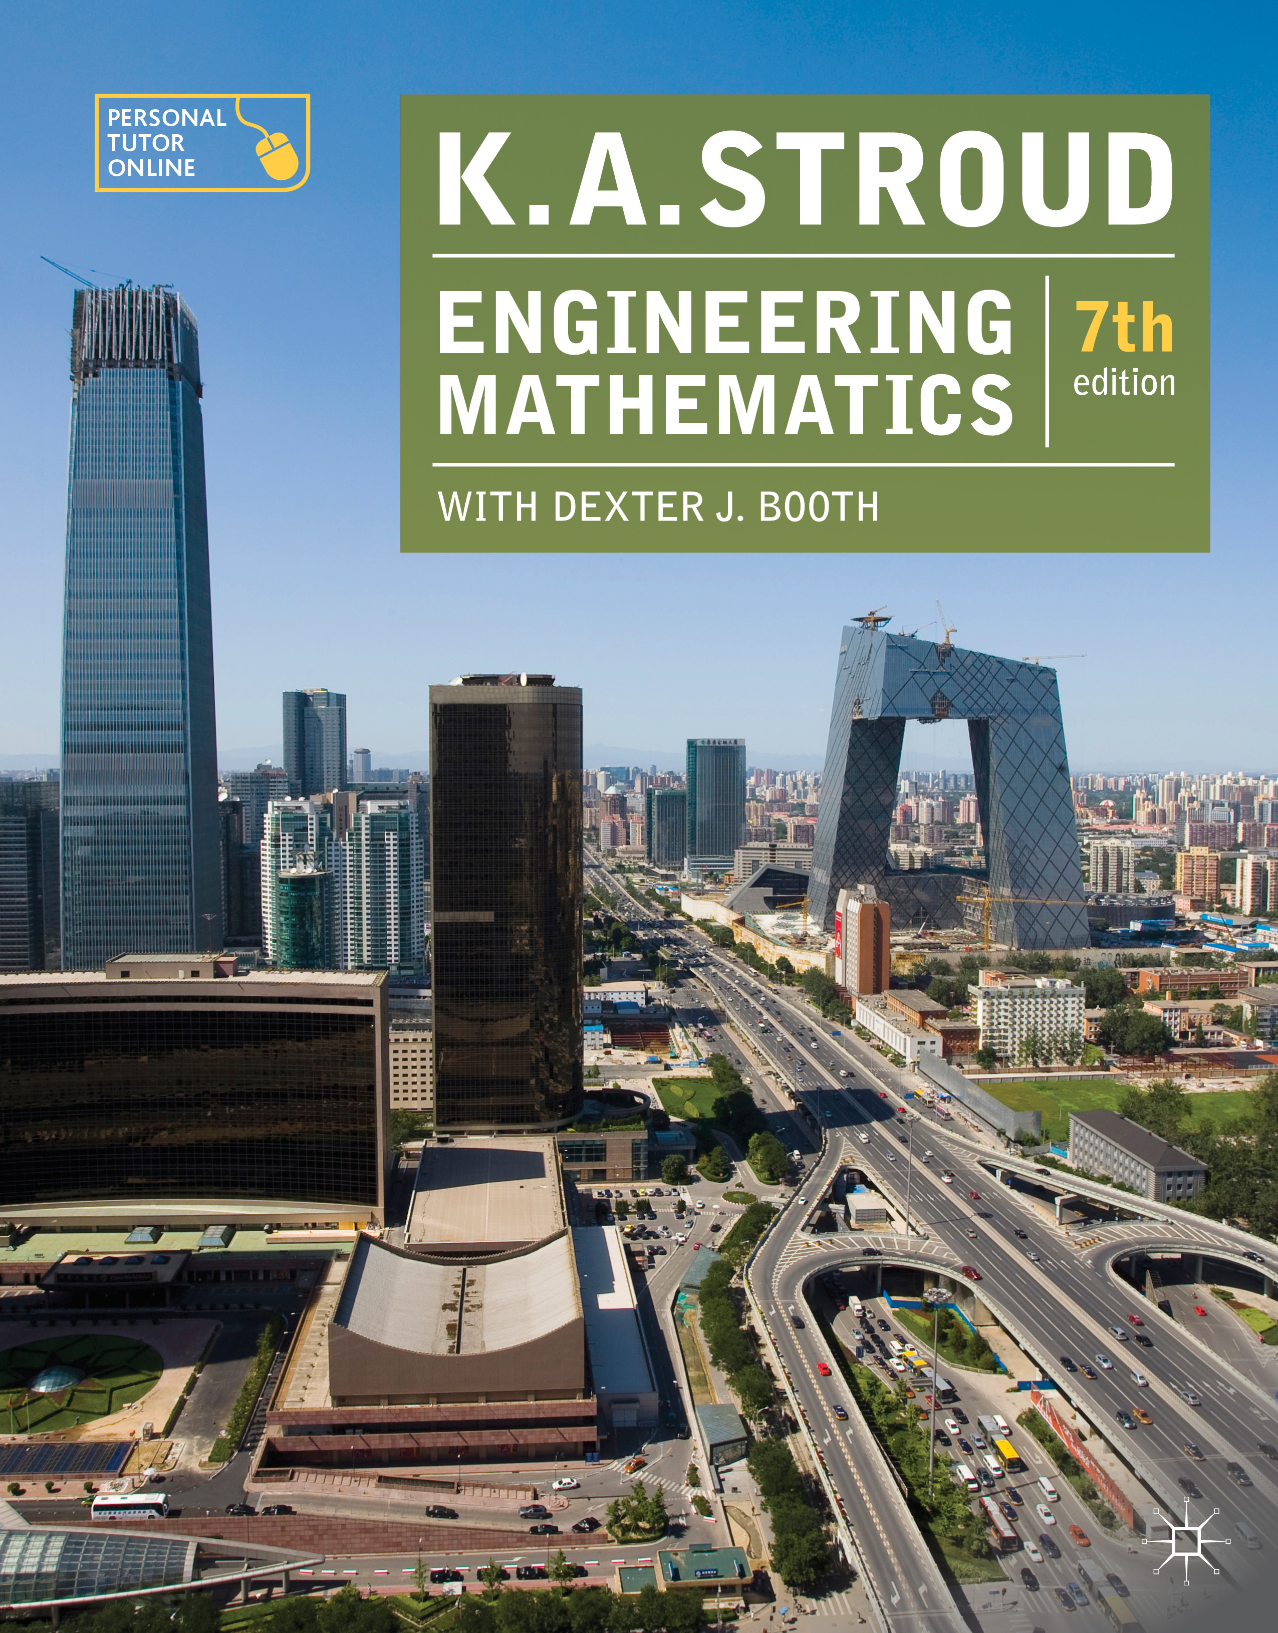
PROGRAMME 10
SEQUENCES

Slide 2
Functions with integer input
Difference equations
Limits of sequences

Slide 3
Functions with integer input
Difference equations
Limits of sequences

Slide 4
Functions with integer input
Sequences
Graphs of sequences
Arithmetic sequences
Geometric sequences
Harmonic sequences
Recursive prescriptions

Slide 5
Functions with integer input
Sequences
Any function f whose input is restricted to positive or negative integer values n has an output in the form of a sequence of numbers. Accordingly, such a function is called a sequence.

Slide 6
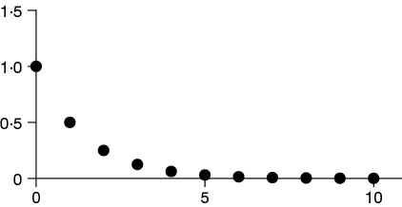
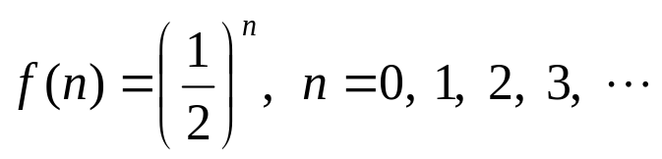
Functions with integer input
Graphs of sequences
Since the output of a sequence consists of a sequence of discrete numbers (the terms of the sequence) the graph of a sequence will take the form of a collection of isolated points in the Cartesian plane.
For example, consider the sequence defined by the prescription

Slide 7

Functions with integer input
Arithmetic sequences
Consider the sequence 2, 4, 6, 8, 10, . . . where each term is obtained from the previous term by adding 2 to it.
Such a sequence is called an arithmetic sequence. In its general form an arithmetic sequence is given by a prescription of the form:
The number a is the first term because it is the output from the function when the input is n = 0. The number d is called the common difference because it is the difference between any pair of successive terms and, despite being called a difference it is in fact the number that is added to a term to find the next term in the sequence.

Slide 8

Functions with integer input
Geometric sequences
Consider the sequence 2, 4, 8, 16, 32, . . . where each term is obtained from the previous term by multiplying it by 2.
Such a sequence is called a geometric sequence. In its general form a geometric sequence is given by a prescription of the form:
The number A is the first term because it is the output from the function when the input is n = 0. The number r is called the common ratio because it is the ratio between any pair of successive terms – it is the number that a term is multiplied by to find the next term in the sequence.

Slide 9
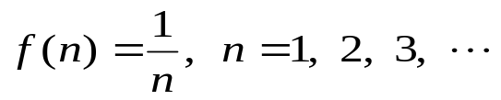
Functions with integer input
Harmonic sequences
A sequence of terms is said to be an harmonic sequence if the reciprocals of its terms form an arithmetic sequence. Accordingly, the sequence defined by the prescription
is an harmonic sequence.

Slide 10

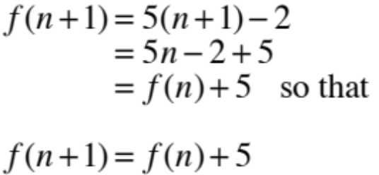
Functions with integer input
Recursive prescriptions
A prescription of a sequence where each term of the sequence is seen to depend upon another term of the same sequence is called a recursive prescription and can make the computing of the terms of the sequence more efficient and very amenable to a spreadsheet implementation. For example, from the prescription
It can be seen that
Is the recursive prescription.

Slide 11


Functions with integer input
Recursive prescriptions
Notice that by itself the recursive prescription
Is of little use because we do not know how to start it off. We need additional information in the form of an initial condition.
Since
then

Slide 12
Functions with integer input
Difference equations
Limits of sequences

Slide 13
Functions with integer input
Difference equations
Limits of sequences

Slide 14
Difference equations
Solving difference equations
Second-order, homogeneous equations
The particular solution

Slide 15

Difference equations
Solving difference equations
The recursive prescription
can be written as
In this form it is an example of a first-order, constant coefficient, linear difference equation also referred to as a linear recurrence relation. It is linear because there are no products of terms such as f (n+1)f (n), it is first-order because f (n+1) is just one term away from f (n), and it has constant coefficients (the numbers multiplying the as f (n) and as f (n+1) are constants and do not involve n).

Slide 16

Difference equations
Solving difference equations
The order of a difference equation is taken from the maximum number of terms between any pair of terms so that, for example:
is a second-order difference equation because f (n+2) is two terms away from f (n).

Slide 17
Difference equations
Solving difference equations
We have seen how the prescription for a sequence such as:
can be manipulated to create the difference equation:
What we wish to be able to do now is to reverse this process. That is, given the difference equation we wish to find the prescription for the sequence which is the solution to the difference equation.

Slide 18

Difference equations
Solving difference equations
Consider the difference equation:
To find the form of the general term f (n) that satisfies this equation we first assume a solution of the form:
where K and w are non-zero real numbers and n is an integer.

Slide 19




Difference equations
Solving difference equations
If we substitute this form for f (n) into the difference equation we find that:
This gives us the characteristic equation:
This means that
We shall, therefore, write the solution as:

Slide 20


Difference equations
Solving difference equations
Using the initial term f (0) = 6 it is then found that:
And so:

Slide 21


Difference equations
Second-order, homogeneous equations
The solution to a second-order, homogeneous difference equation follows the same procedure with the exception that the characteristic equation has two roots and so a linear combination of two solutions is required as well as the application of two initial conditions.
For example, the difference equation
Gives rise to the characteristic equation
and hence the solution

Slide 22


Difference equations
Equal roots of the characteristic equation
If the roots of the characteristic equation are equal then a different form for the solution must be given.
For example, the difference equation
Gives rise to the characteristic equation
and hence the solution

Slide 23
Functions with integer input
Difference equations
Limits of sequences

Slide 24
Functions with integer input
Difference equations
Limits of sequences

Slide 25
Limits of sequences
Infinity
Limits
Infinite limits
Rules of limits
Indeterminate limits

Slide 26
Limits of sequences
Infinity
There is no largest integer; this fact is embodied in the statement that the integers increase without bound – no matter how large an integer you can think of you can always add 1 to it to obtain an even larger integer. An alternative description of this idea is to say that the integers increase to infinity where infinity is represented by the symbol ∞ (negative infinity is represented by −∞). Unfortunately, because we have a symbol for it there is a temptation to give infinity some numerical aspect that it does not possess. It must be clearly understood that although infinity is a well-established concept it cannot be defined numerically and so it cannot be used as a number in any arithmetic calculations.

Slide 27
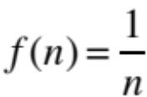
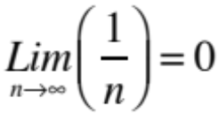
Limits of sequences
Limits
The number that the output of a sequence approaches as the input increases without bound is called the limit of the sequence.
For example, no matter how large n becomes never attains the value of 0.
However, it can become as close to 0 as we wish by choosing n to be sufficiently large.
We call 0 the limit of as n approaches infinity and write

Slide 28


Limits of sequences
Infinite limits
Sometimes as n becomes large so does f (n).
For example, the output from the sequence becomes large even faster than n does. In this case we write the limit as:
Be aware. This notation can be misleading if it is not correctly understood. It does not mean what it appears to mean, namely that the limit is equal to infinity. It cannot be equal to infinity because infinity is not numerically defined so nothing can be said to be equal to it. What it does mean is that as n becomes large without bound then so does n³.
If a sequence has a finite limit it is said to converge to that limit.
If a sequence does not have a finite limit it is said to diverge.

Slide 29

Limits of sequences
Rules of limits
Multiplication by a constant
The limit of an expression multiplied by a constant is the constant multiplying the limit of the expression:
where k is a constant.

Slide 30

Limits of sequences
Rules of limits
Sums and differences
The limit of a sum (or difference) is the sum (or difference) of the limits:

Slide 31
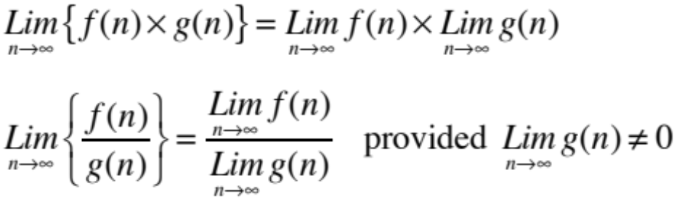
Limits of sequences
Rules of limits
Products and quotients
The limit of a product (or quotient) is the product (or quotient) of the limits:

Slide 32
Limits of sequences
Indeterminate limits
Sometimes when trying to determine the limit of a quotient the limits of both the numerator and the denominator are infinite. Such a limit is called an indeterminate limit and cannot be found without some manipulation on the quotient.

Slide 33
Learning outcomes
Understand the nature of probability as a measure of chance
Compute expectations of events from an experiment with a number of outcomes
Assign classical measures to the probability and be able to define the probabilities of both certainty and impossibility
Distinguish between mutually exclusive and mutually non-exclusive events and compute their probabilities
Compute conditional probabilities
Evaluate permutations and combinations
Use the binomial and Poisson probability distributions to calculate probabilities
Use the standard normal probability distribution to calculate probabilities

